Slide 1
Tech Educators’ Summit Faculty Build-a-thon 2025
“Exploring the Power of Agentic AI with IBM Granite and LangFlow”

Slide 2


Name of the team: SKYMINDS
Details of Team members
TEAM MEMBER NAME | Recent Passport Photo | Email ID | Phone number [WhatsApp]

Slide 3

Travel Agent
The Challenge Travel planning can be overwhelming, as individuals often struggle with:
Information overload – browsing multiple sites for flights, hotels, and activities.
Personalization gaps – generic suggestions that don’t match user interests, budgets, or travel styles.
Unreliable sources – scattered, inconsistent information about destinations, local culture, or safety.
Dynamic conditions – sudden changes in weather, transport schedules, or local advisories.
Without a reliable, intelligent assistant, travelers spend excessive time researching and still end up making suboptimal choices, leading to poor travel experiences, overspending, or missed opportunities.

Slide 4

We are using Agentic AI system .

Slide 5
Solution Overview
We are going to use Langflow platform . We are using IBM granite models .

Slide 6
Langflow component Used
Explain the use of each langflow component used into you project
1)Chat Input –
2) IBM watsonx AI Agent
File component
Chat output
Add name of any other component used.

Slide 7
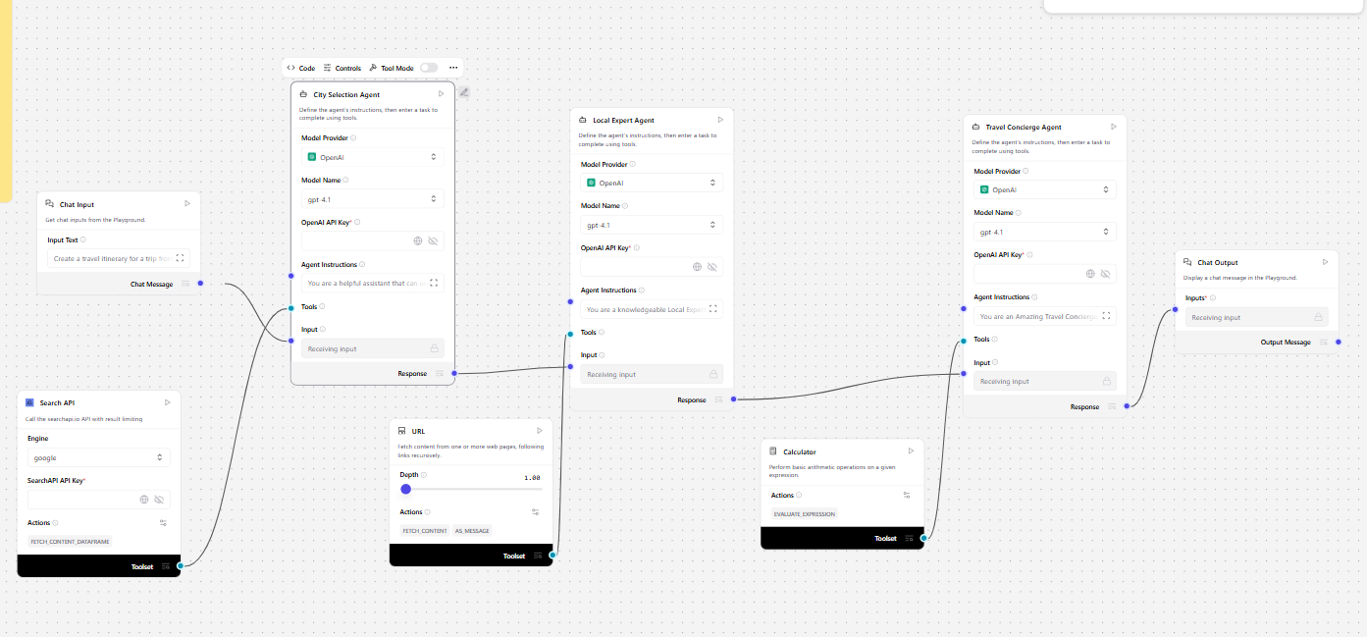
Architecture blueprint

Slide 8
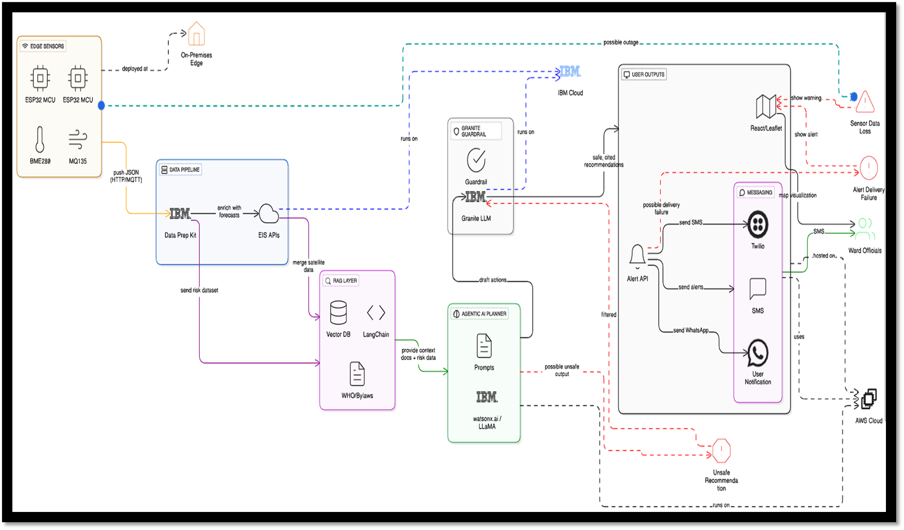
Architecture blueprint

Slide 9

Role of Agentic AI and Gen AI in the solution
Explain how GenAI , Agentic AI help to find solution of the problem

Slide 10
Technology Used
Langflow platform
Langflow component name – Agent , Chat input , Chat output
IBM Grainte model - for eg – ibm-granite-3-2-8b
IBM Cloud
RAG if used
IBM Watsonx.ai
Watsonx

Slide 11
Novelty and Uniqueness
· First platform merging micro‑climate sensing, GenAI, and policy
retrieval for urban adaptation.
· Uses non‑wearable, rooftop nodes—cheaper and easier to deploy
city‑wide.
· Granite‑guarded outputs ensure bias‑free, regulation‑compliant
advice.
· 5‑second loop from sensor trigger to official alert.

Slide 12
Git Hub Link
· Please create public github repository (Enable Add README button while creating repository) with format –
Please test and Paste the working Github URL –
Make sure you have Uploaded following three files into your github repository 1) app.py file , 2) your_hackthon_problemstatement.pdf file 3) your projectpresntation.pptx file
·
·
·

Slide 13
Future Scope
·[ write your project future scope]
·
·
·

Slide 14


